Slide 1


A Smart IoT-Based Real-Time Water Quality Monitoring System for Aquaculture Using SMOTE-Enhanced Random Forest Models

Slide 2
Course Code: | EEE 4103 | Course Name: | Microprocessor and Embedded Systems
SL # | Students ID | Students Name | Program | Section
1 | 22-48056-2 | Chinmoy Guha | BSc in CSE | O
2 | 22-47975-2 | Mohammad Ansar Uddin | BSc in CSE | O
3 | 23-54266-3 | Mashkur Ibtesham Wazed | BSc in CSE | O
4 | 23-50834-1 | Nafiur Rahman Siam | BSc in CSE | O
5 | 23-54270-3 | Arfanul Hoque Nehal | BSc in CSE | o
6 | 22-48067-2 | Suvra Chakraborty | BSc in CSE | o

Slide 3
Contents of this Presentation
Aims and Objectives
Introduction
Survey Report
Literature Review
Research/Working Method
Methodology
Results, Outcomes, and Discussions
Conclusions
Future Works

Slide 4
Aims and Objectives of the work.
Primary Aim:
To design and implement a low-cost, IoT-enabled water quality monitoring and prediction system for aquaculture farms, integrating real-time sensor data acquisition with machine learning–based water quality classification, in order to support timely decision-making and reduce fish mortality.
Objectives
Design an IoT sensing system to measure pH, temperature, turbidity, and conductivity in real time
Stream sensor data to the ThingSpeak cloud platform for monitoring and storage
Develop a Random Forest–based machine learning model to classify water quality as Excellent, Good, or Poor
Evaluate model performance using accuracy, F1-score, recall, and confusion matrix
Enable real-time prediction and automated control (aerators/pumps) using relay-based actuation

Slide 5
Introduction:
Background:
Aquaculture is a major food source in Bangladesh Contributes significantly to protein supply and rural economy
Water quality directly affects fish health and yield Small changes in pH, temperature, or turbidity can cause stress or death
Most small farms rely on manual observation Visual checks are inaccurate and often too late
Poor monitoring leads to high economic losses Sudden water quality failure causes mass fish mortality

Slide 6
Introduction:
Motivation:
Need for real-time and continuous monitoring Instant detection is critical in aquaculture environments
IoT enables low-cost remote sensing and cloud monitoring Sensors + WiFi allow 24/7 data access
Raw sensor data is hard to interpret for farmers Numerical values do not clearly indicate water condition
Machine learning enables intelligent decision support Automatic classification of water quality as Excellent, Good, or Poor
Goal: Reduce fish mortality and farmer workload Early prediction + automation improves farm sustainability

Slide 7
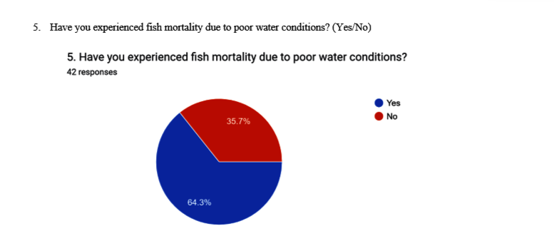
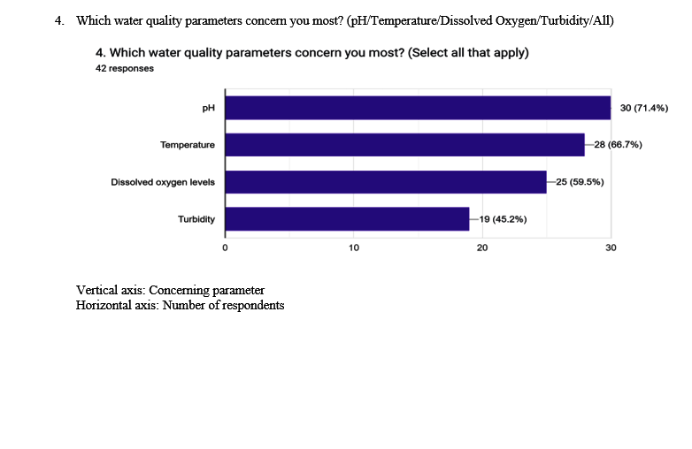
Survey Report:

Slide 8
Literature Review:
Low-cost IoT sensor systems are widely used for aquaculture water monitoring
Jais et al. (2024) showed that affordable pH and water-level sensors suffer from noise
Software-based filtering (moving average) improved accuracy with R² > 0.93
Shete et al. (2024) implemented an ESP32-based IoT system for pH, turbidity, and temperature
Their system enabled real-time cloud monitoring but required stable internet connectivity

Slide 9
Literature Review:
Olanubi et al. (2024) integrated automation using fuzzy logic and actuators
Automated aeration and water control reduced fish mortality by 96.5%
Abdikadir et al. (2024) used NodeMCU with mobile alerts for remote monitoring
Duangwongsa et al. (2021) showed instant notifications improve response time
Identified Gaps in Existing Systems: – Limited use of machine learning for water quality classification – Monitoring-focused designs with little or no prediction capability – Interfaces not optimized for small-scale farmers
Motivation for This Work: – Develop a low-cost IoT system with integrated machine learning – Enable real-time prediction and automated control – Ensure suitability for rural aquaculture in Bangladesh

Slide 10
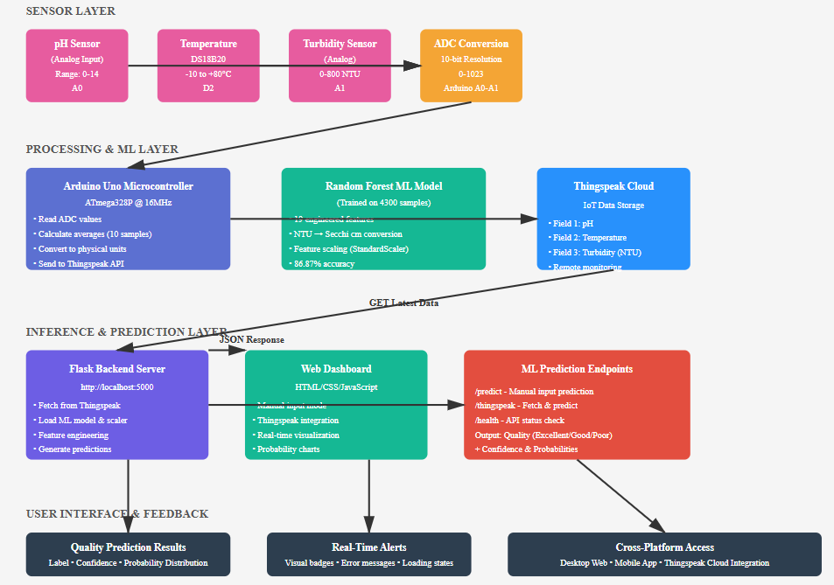
Working Method:
Block Diagram:

Slide 11
Working Method:
Sensor Data Acquisition pH, temperature, and turbidity sensors generate analog signals read by the Arduino Uno. Data is sampled at fixed intervals and averaged to reduce sensor noise.
Local Pre-Processing Raw sensor values are filtered and calibrated on the microcontroller to improve reliability before transmission.
Wireless Data Transmission Processed sensor data is sent via WiFi to the ThingSpeak cloud platform for real-time logging and visualization.
Machine Learning–Based Prediction Cloud-stored data is fed into a trained Random Forest model that classifies water quality as Excellent, Good, or Poor using engineered features.
User Feedback and Control Farmers can monitor water conditions through dashboards

Slide 12
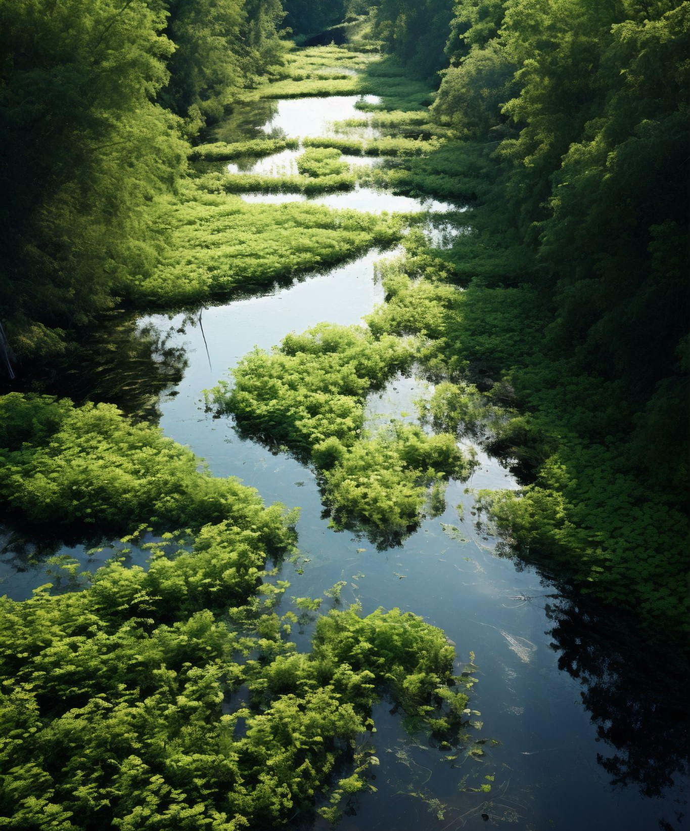
Methodology

Slide 13
System Development:
Selection of key water quality parameters: pH, temperature, and turbidity
Design of an embedded system using Arduino Uno and calibrated analog sensors
Implementation of noise reduction through sampling and averaging
Integration of WiFi module for real-time data transmission

Slide 14
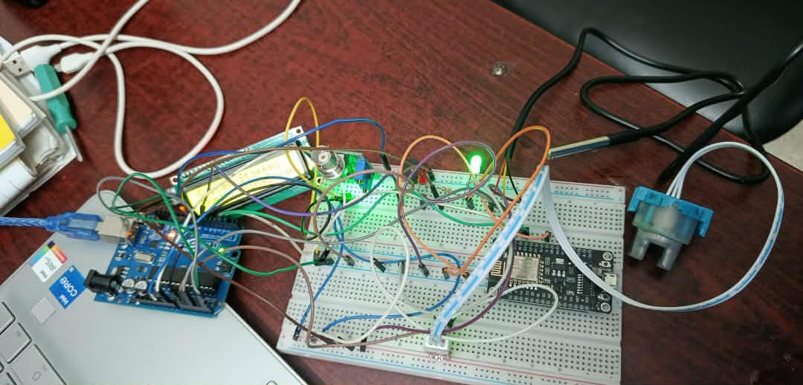
System Development:

Slide 15
IoT Data Flow:
Continuous acquisition of sensor data at fixed time intervals
Transmission of processed data to ThingSpeak cloud platform
Real-time visualization and cloud data logging
Can see the data in LCD as well as see ML prediction in website.

Slide 16
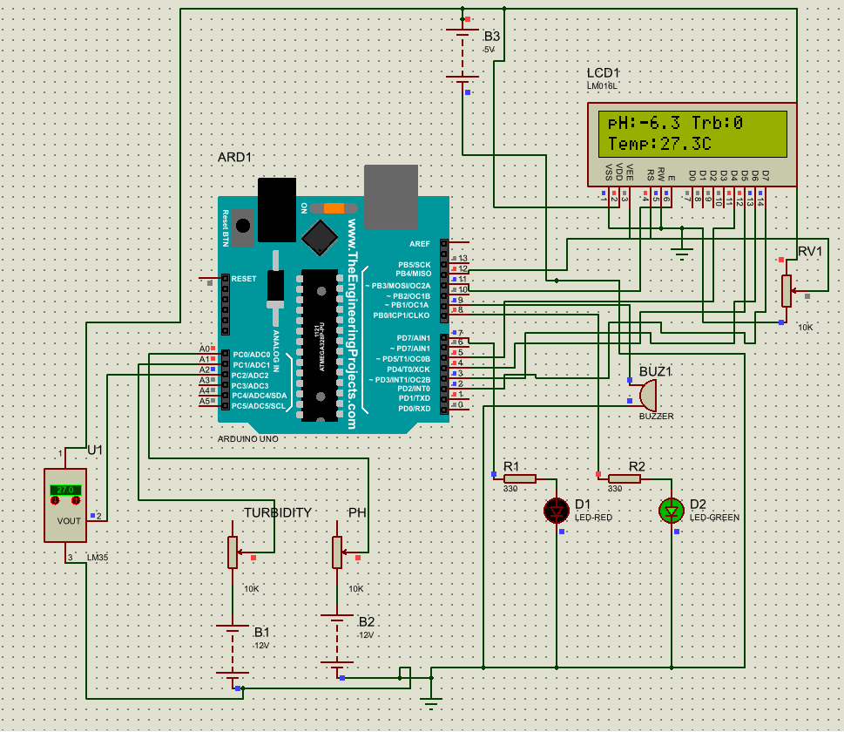
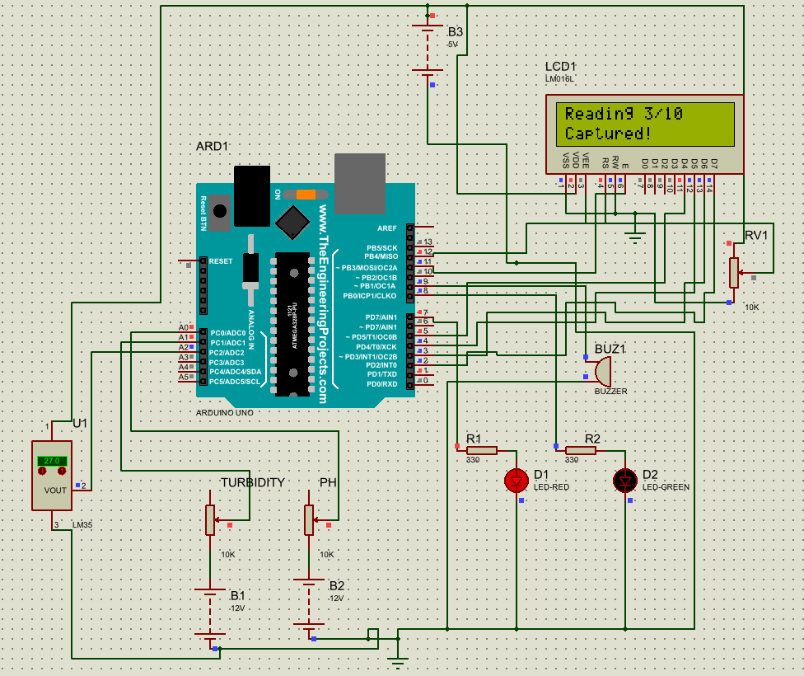
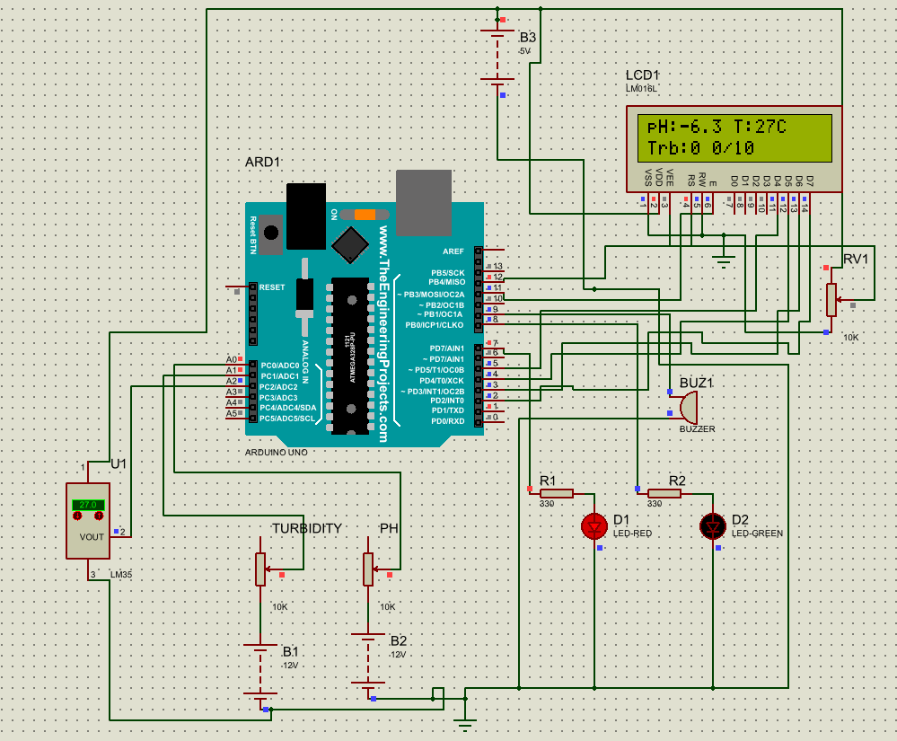
Proteus Simulation:

Slide 17
Machine Learning Model:
Collection and cleaning of historical data (https://data.mendeley.com/datasets/y78ty2g293/1)
Feature engineering from pH, temperature, and turbidity values
Dataset balancing using SMOTE to handle class imbalance
Training of multiple models with k-fold cross-validation
Model evaluation using accuracy, precision, F1-score, recall, and confusion matrix
Deployment of best trained model for real-time water quality classification

Slide 18
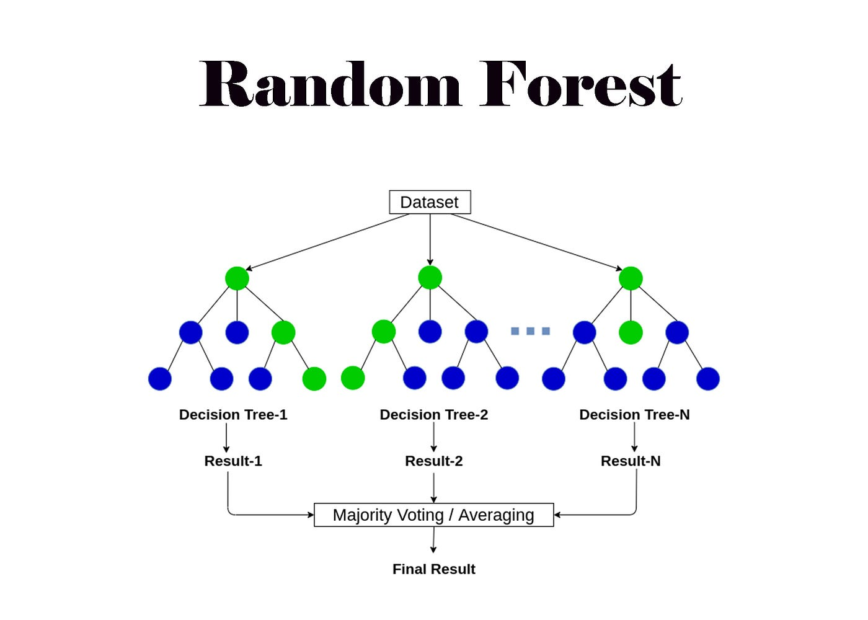
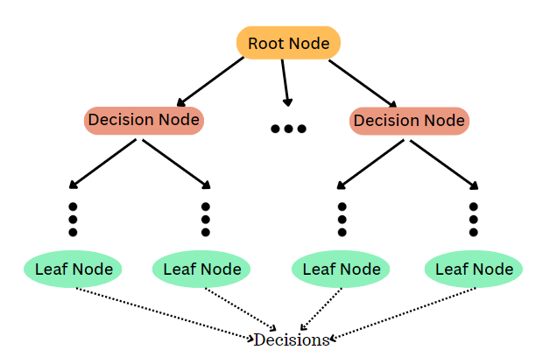
Machine Learning Model:

Slide 19
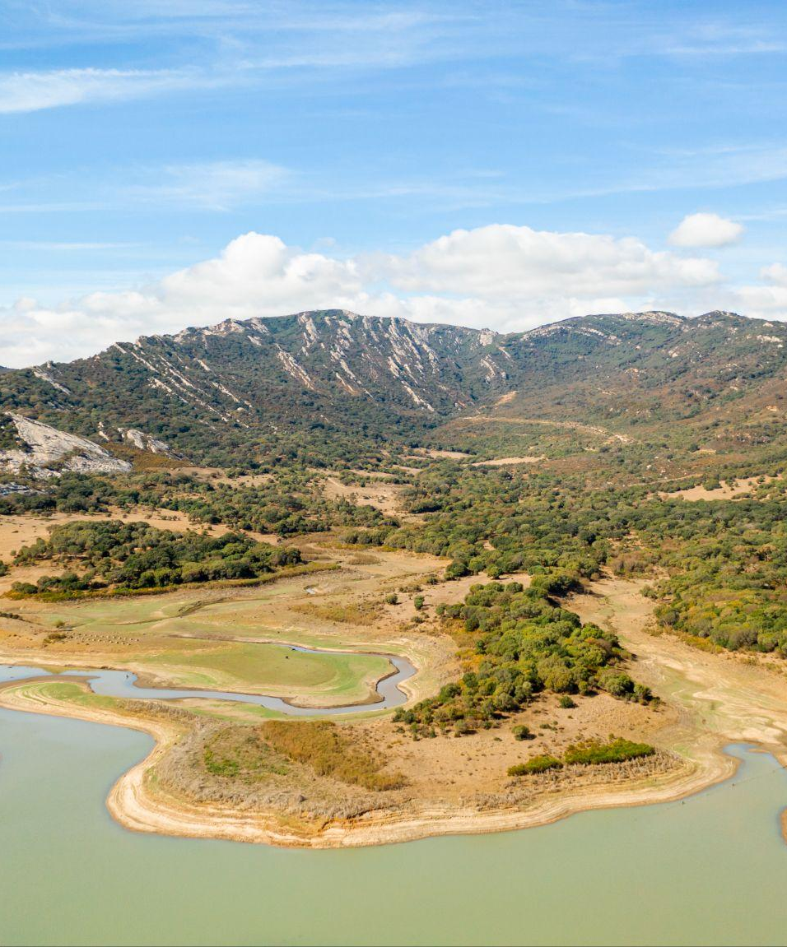
Results

Slide 20
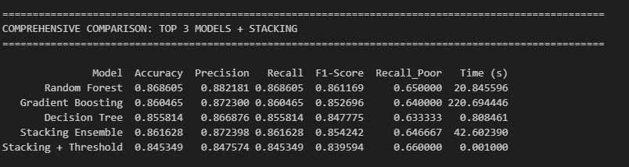
Results
Machine Learning Model:

Slide 21
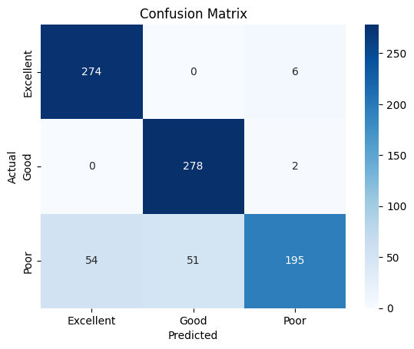
Results
Machine Learning Model:

Slide 22
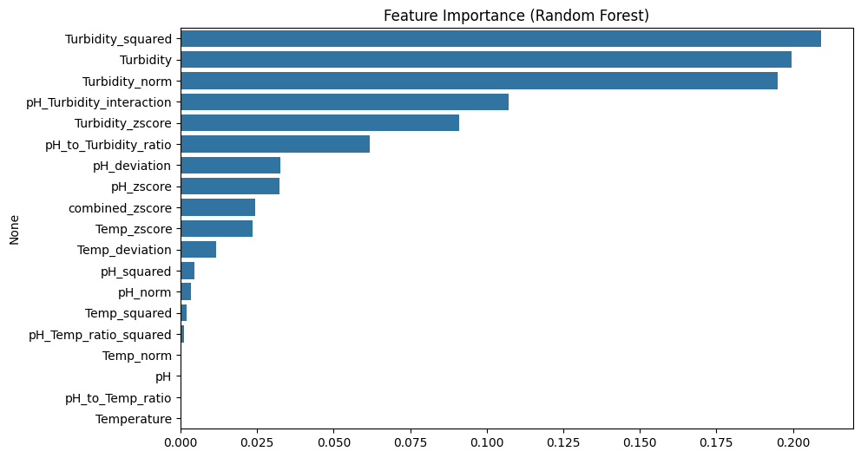
Results
Machine Learning Model:

Slide 23
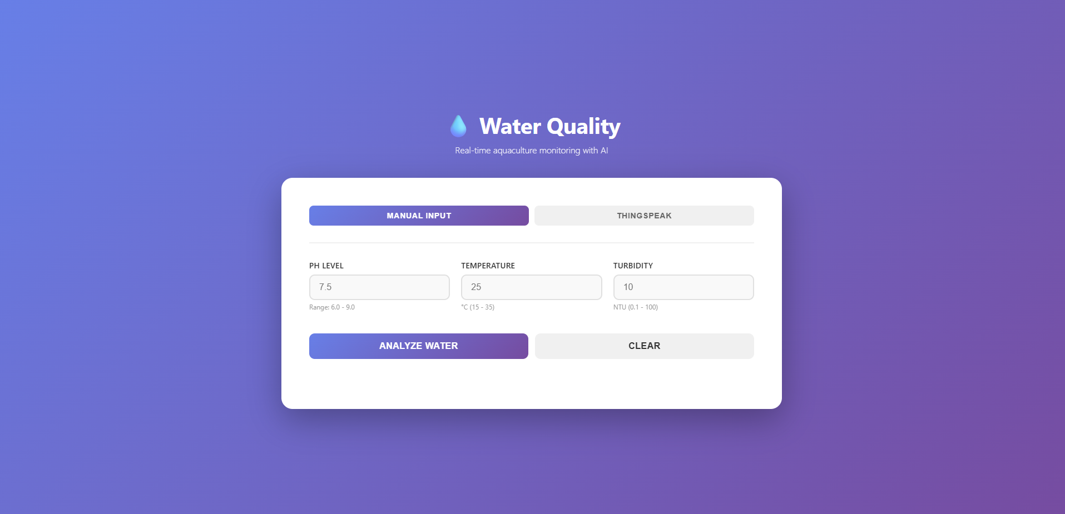
Results
Website:

Slide 24
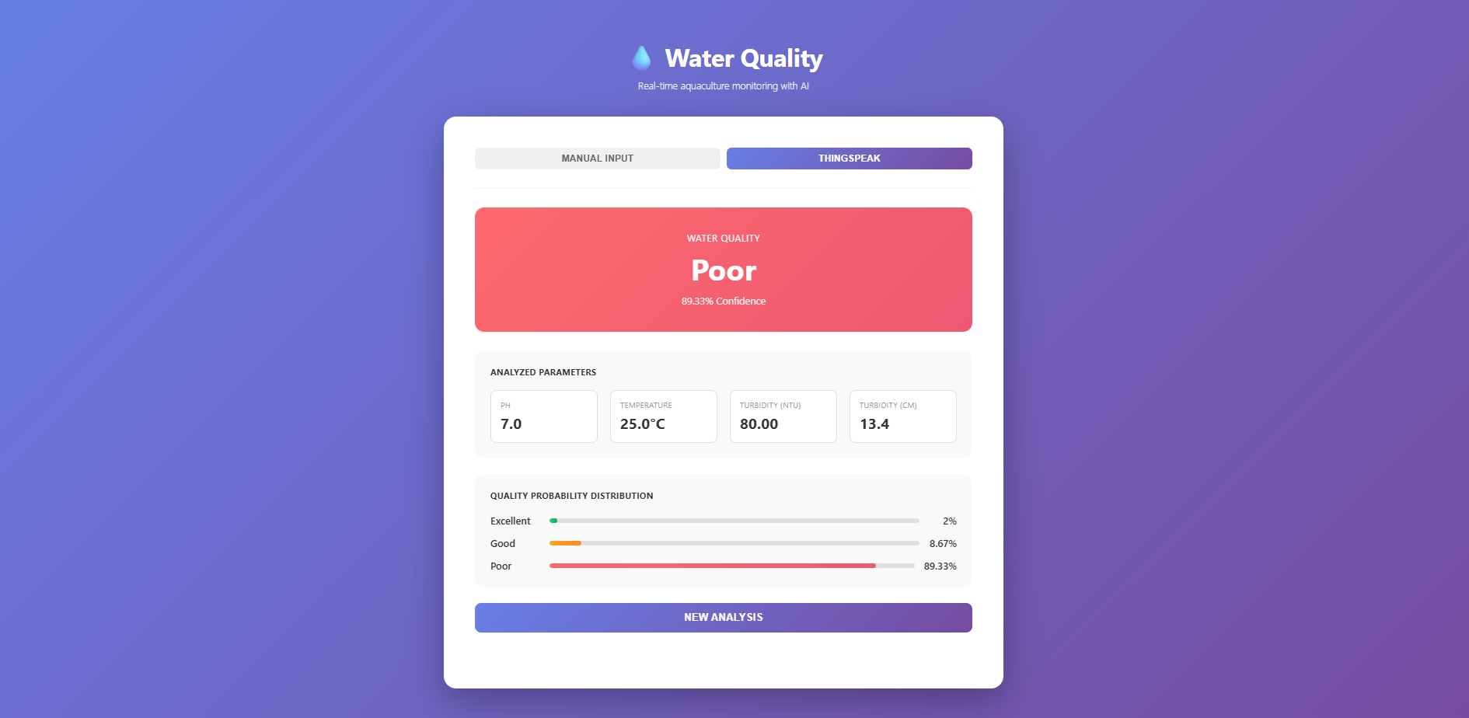
Results
Website PREDICTION:

Slide 25
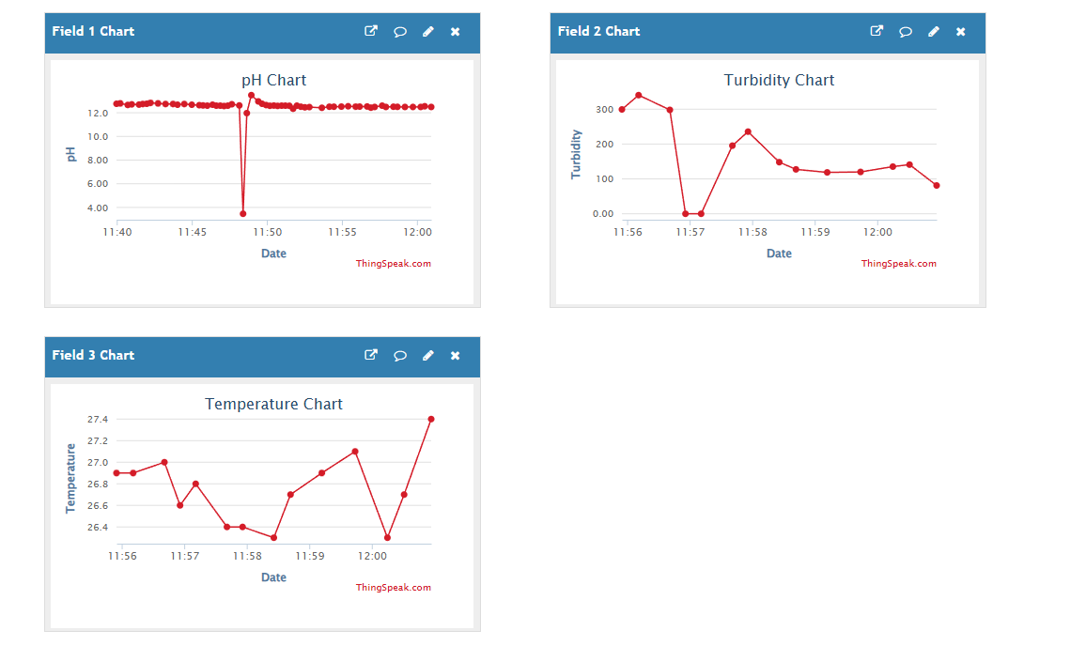
Results
ThinkSpeak Application:

Slide 26
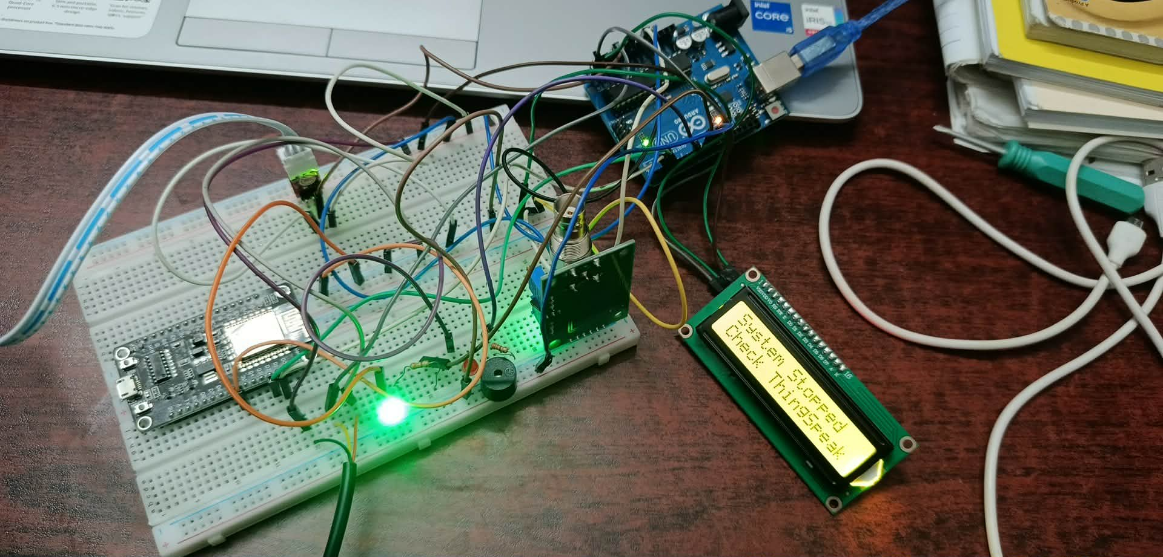
Results
Hardware:

Slide 27
Conclusions:
The system integrates real-time data acquisition via sensors measuring pH, temperature, and turbidity, combined with cloud-based monitoring using ThingSpeak.
A Random Forest machine learning model, enhanced using SMOTE to address class imbalance, was developed to classify water quality as Excellent, Good, or Poor.
Model performance was evaluated using accuracy, F1-score, recall, and confusion matrix, showing reliable prediction capabilities.
The project supports real-time automation, reducing manual labor and enabling timely intervention based on machine learning predictions.

Slide 28
Future Scopes:
While the original slide mentions "Future Works" without detailed bullet points, based on the project scope and current limitations, the future directions likely include:
Integration of more parameters: Add sensors for dissolved oxygen (DO), ammonia, or nitrate for a more comprehensive assessment.
Mobile app interface: Develop farmer-friendly mobile applications for alerts and analytics.
Offline functionality: Introduce edge computing or local processing for use in areas with unreliable internet.
Broader ML model adaptation: Use deep learning or other ensemble methods for enhanced accuracy.
Scalability testing: Deploy in various farm environments to evaluate robustness and adaptability.

Slide 29
Thanks for listening our presentation

